Slide 1
Angular Product Inventory Management System
Presented by: DINESH ADHITHYA S B
Date: 16/03/2025

Slide 2
Introduction
Project Type:
This project is a frontend-only Product Inventory Management System built using Angular.
Purpose:
It provides a user-friendly interface for managing product details, including adding, editing, deleting, and searching products.
Modular Design:
The project follows a component-based architecture, making it scalable and easy to maintain.
Tech Stack:
Uses Angular, TypeScript, Bootstrap, and CSS for a dynamic and responsive UI.
Mock Data:
Uses db.json or Local Storage to simulate backend API responses.

Slide 3
Project Structure
src/app
core/: Contains global services and utility functions.
features/: Implements product-related features.
shared/: Reusable components like buttons, tables, and forms.
app.module.ts: The root module for Angular components.
assets/db.json: Mock database for local development.
angular.json: Project configuration settings.

Slide 4
Key Features
Product Management:
Add, edit,view and remove products.
Dynamic UI:
Responsive design using Angular.
Mock Backend:
Uses db.json for API simulation.
Routing:
Navigation with Angular Router.

Slide 5
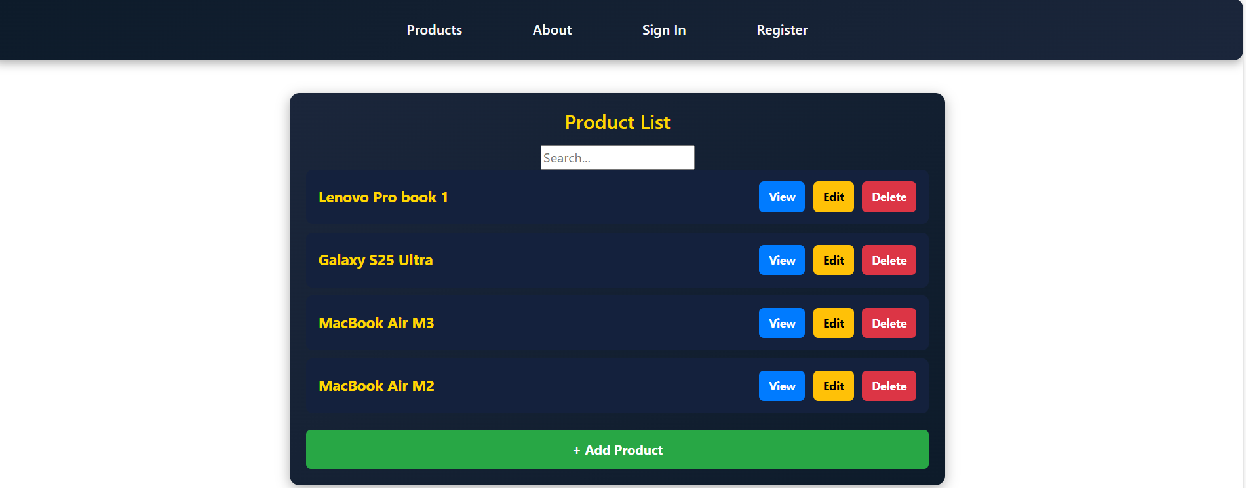
Application Screenshots

Slide 6
Future Implementation
Backend Integration:
Implement a Spring Boot or Node.js backend with a MySQL or Firebase database.
Authentication & Authorization:
Add user login, role-based access control (Admin, User) using JWT authentication.
Cloud Deployment:
Deploy the project on AWS, Firebase, or Vercel for real-time accessibility.
Image Upload Feature:
Allow users to upload product images for better visualization.
PWA (Progressive Web App):
Make the system installable as a mobile/web app for offline access.

Slide 7
Summary & Final Thoughts
Successfully developed a frontend Product Inventory Management System using Angular.
Implemented essential features like CRUD operations, search, and responsive UI.
The project is scalable and can be enhanced with backend integration.
Future enhancements will focus on security, advanced filtering, and analytics.
This system is a valuable tool for small businesses and inventory tracking needs.

Slide 8
THANK YOU

